Slide 1
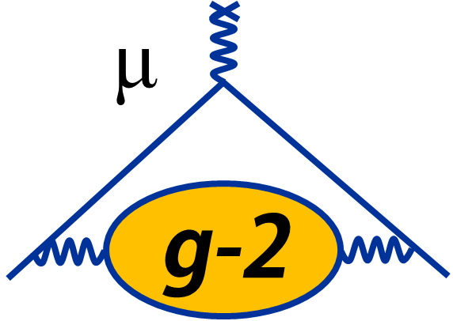
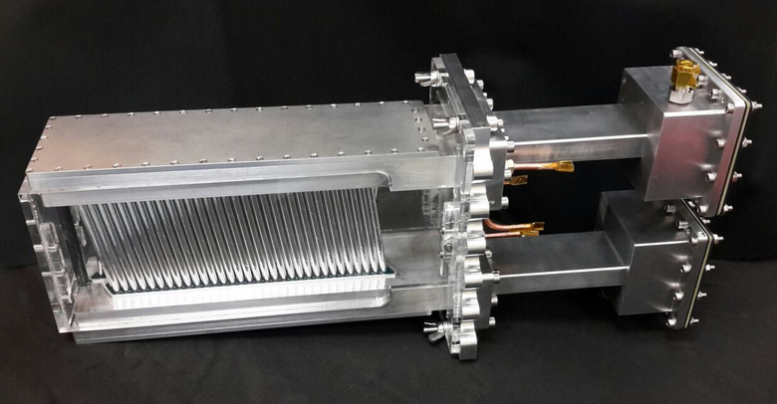
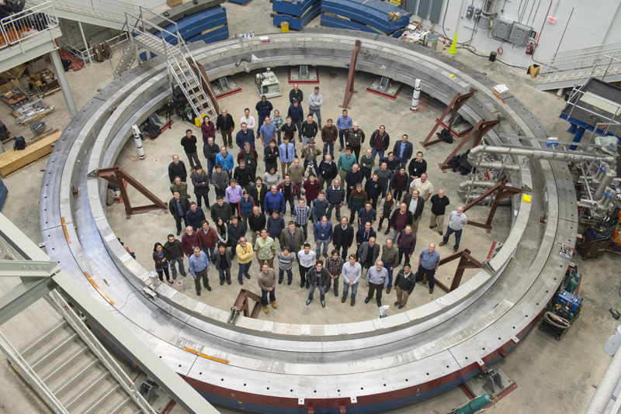
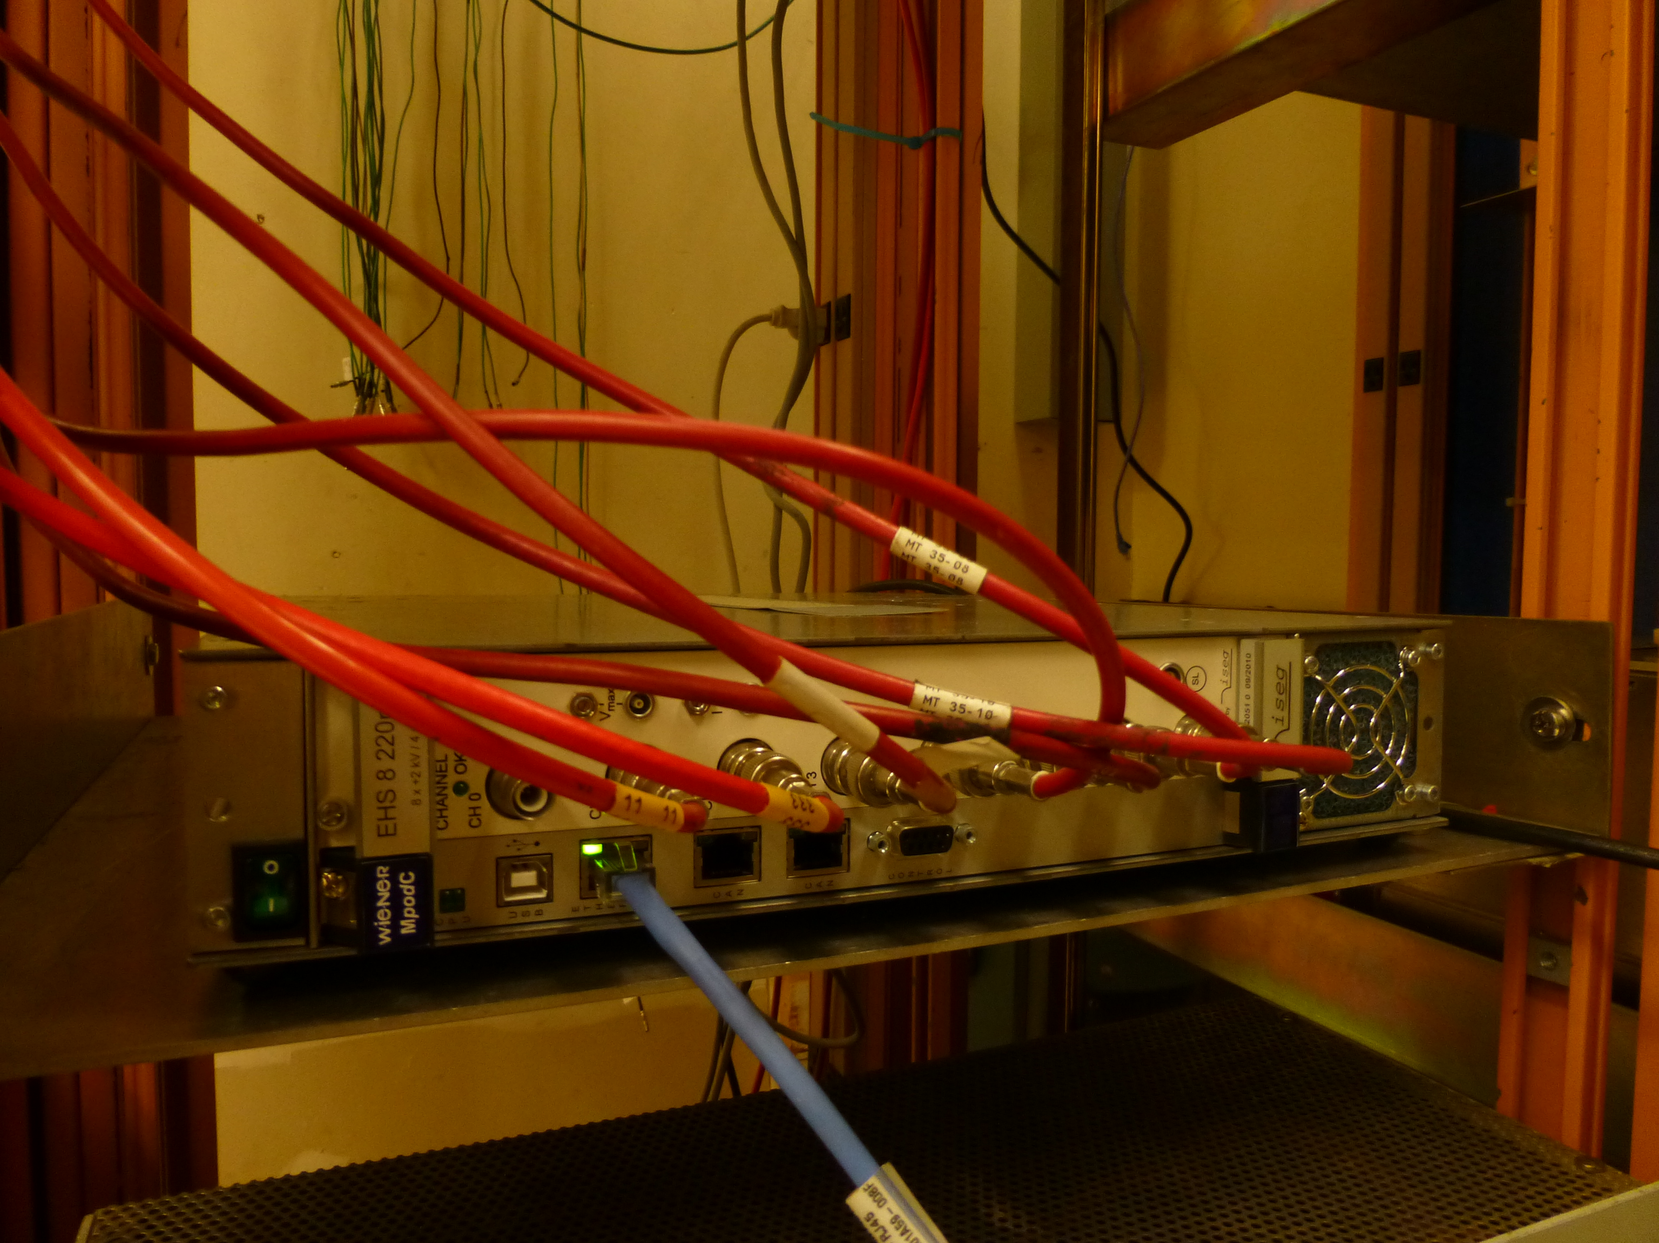
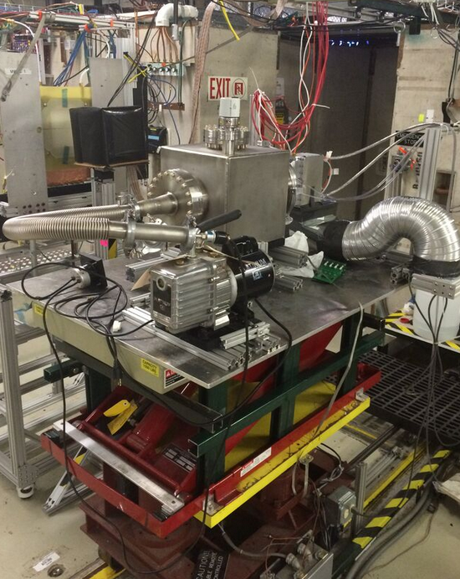
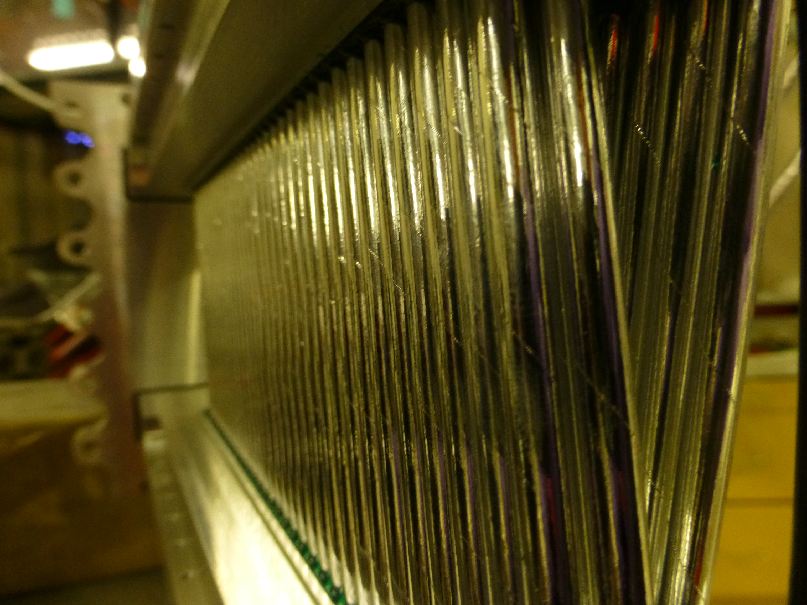
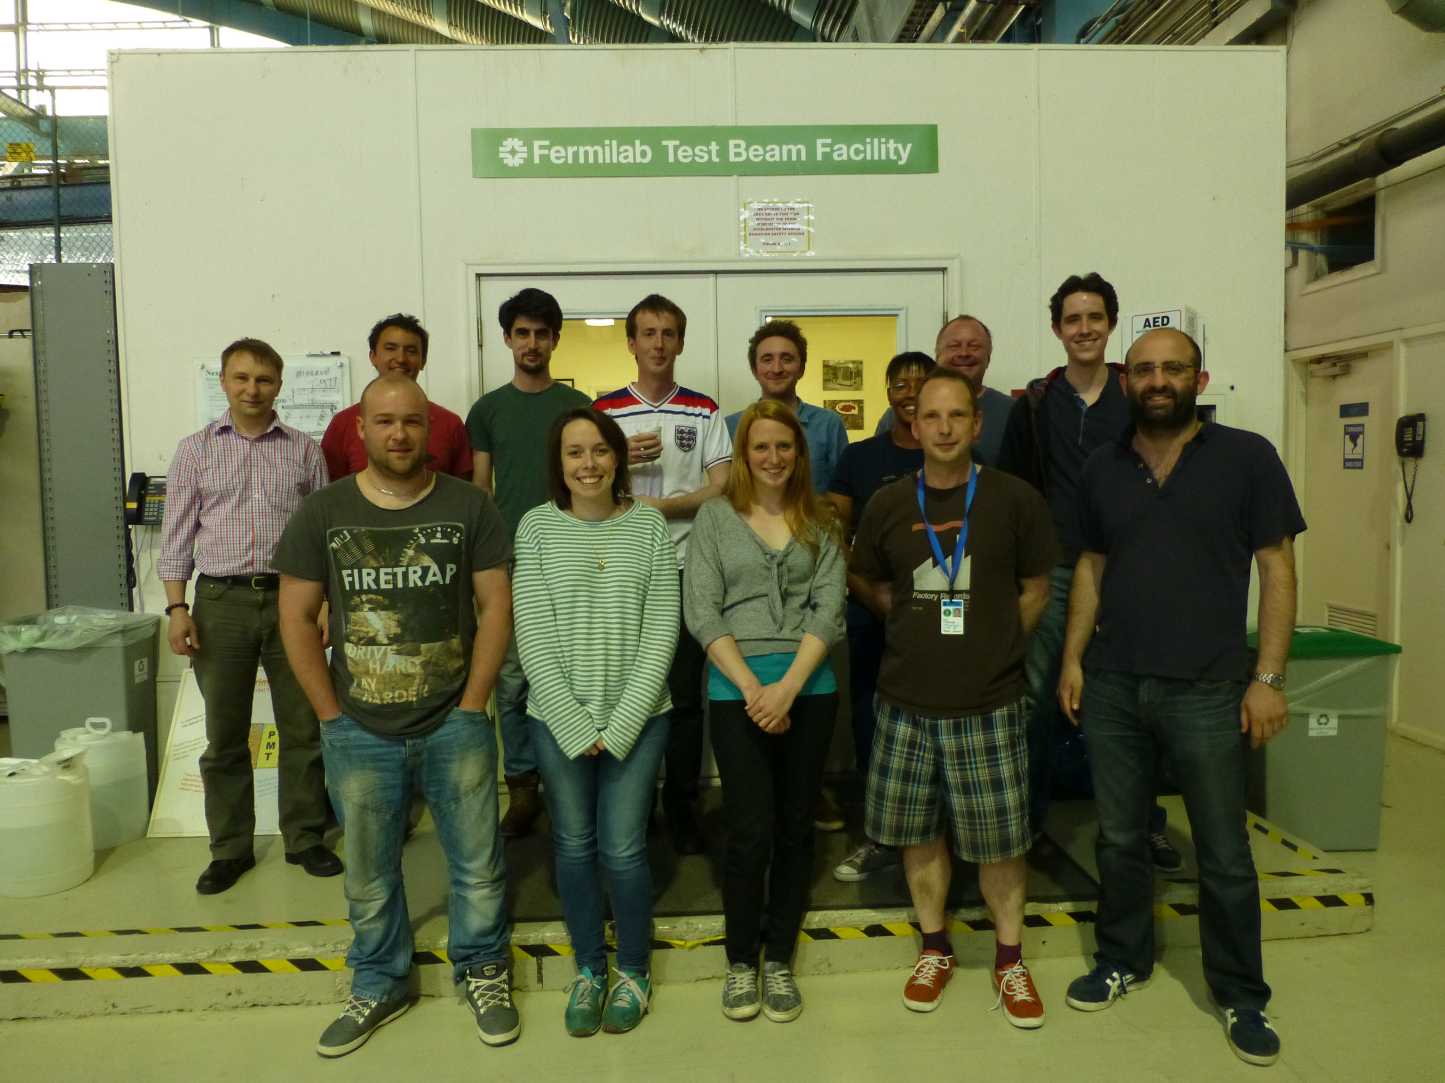
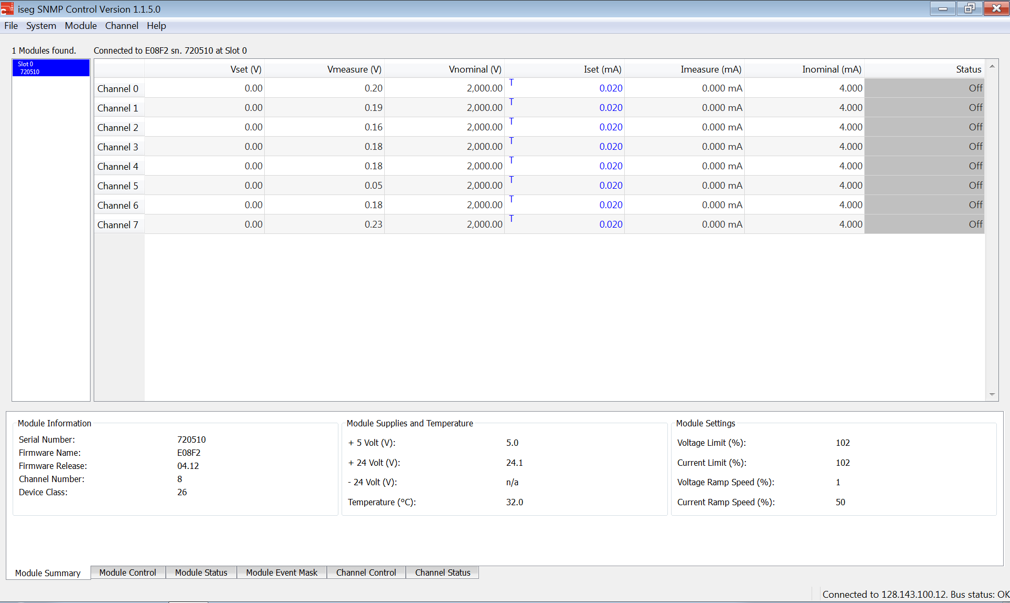

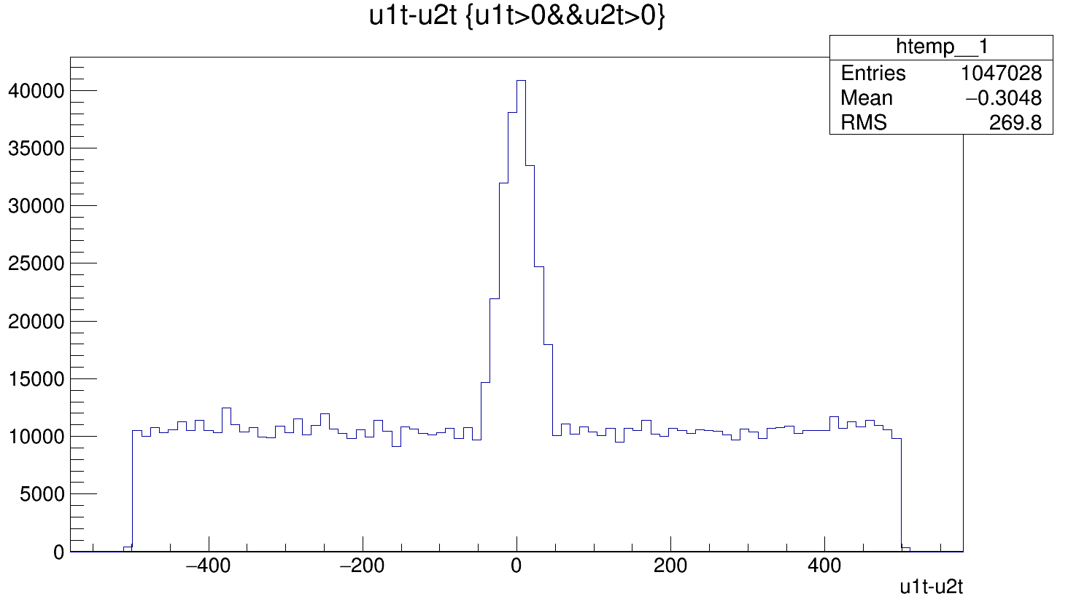
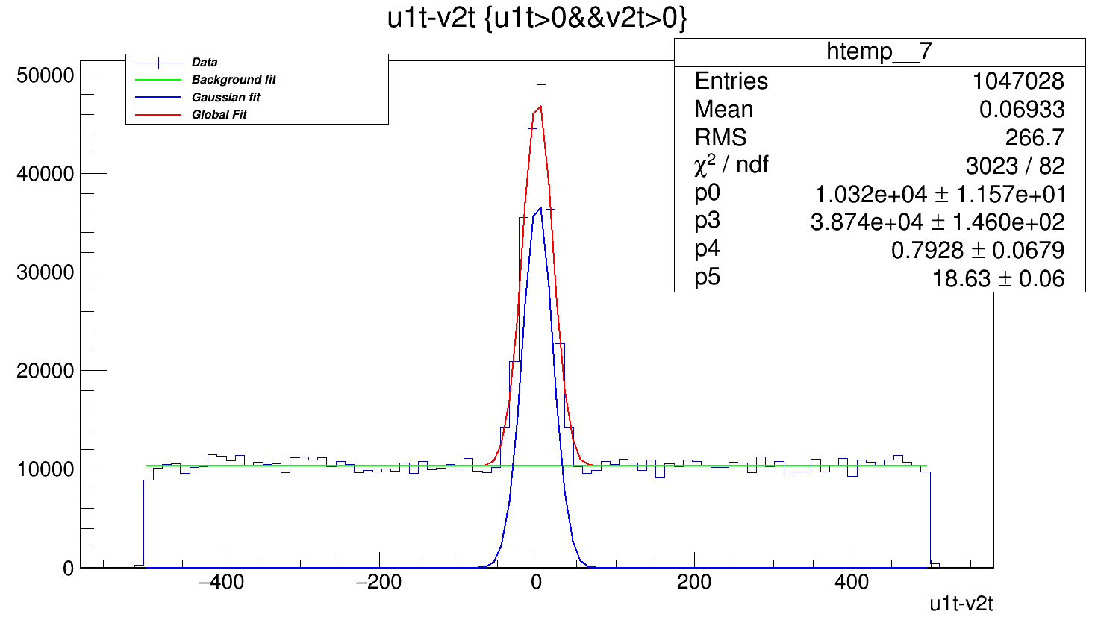
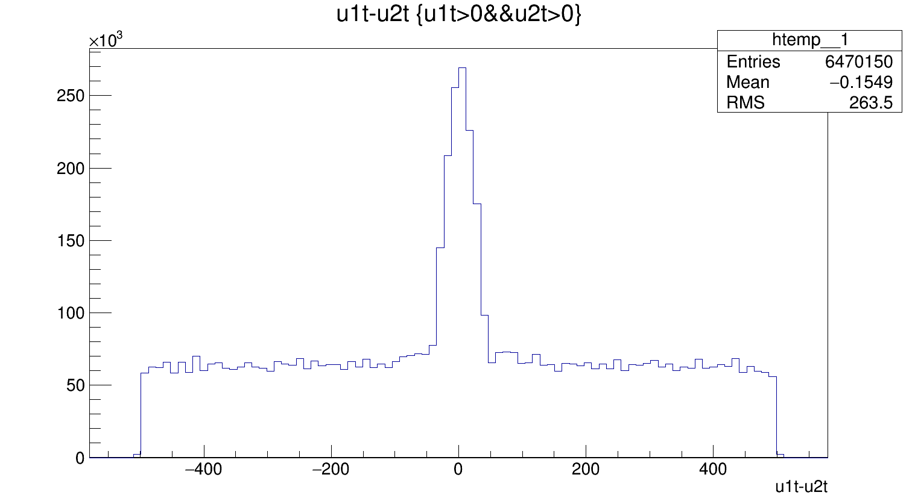
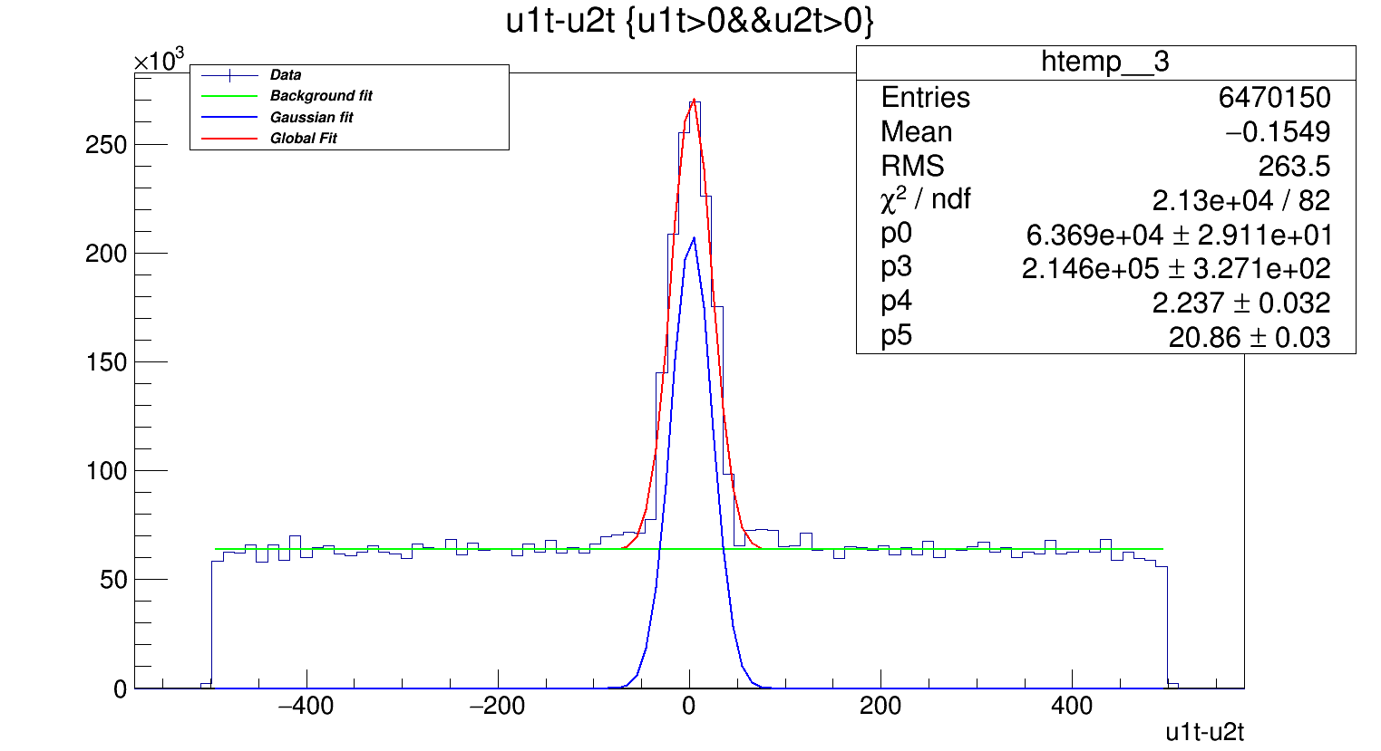
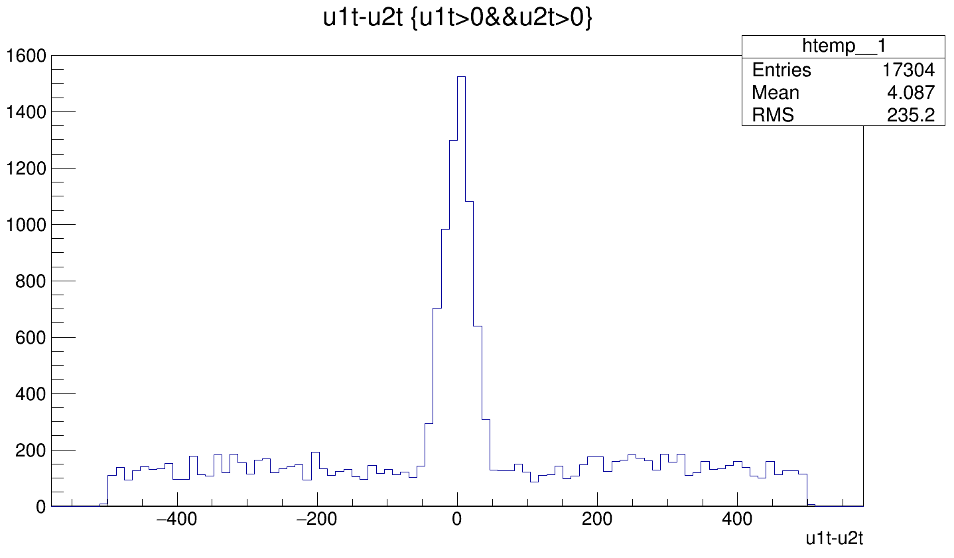
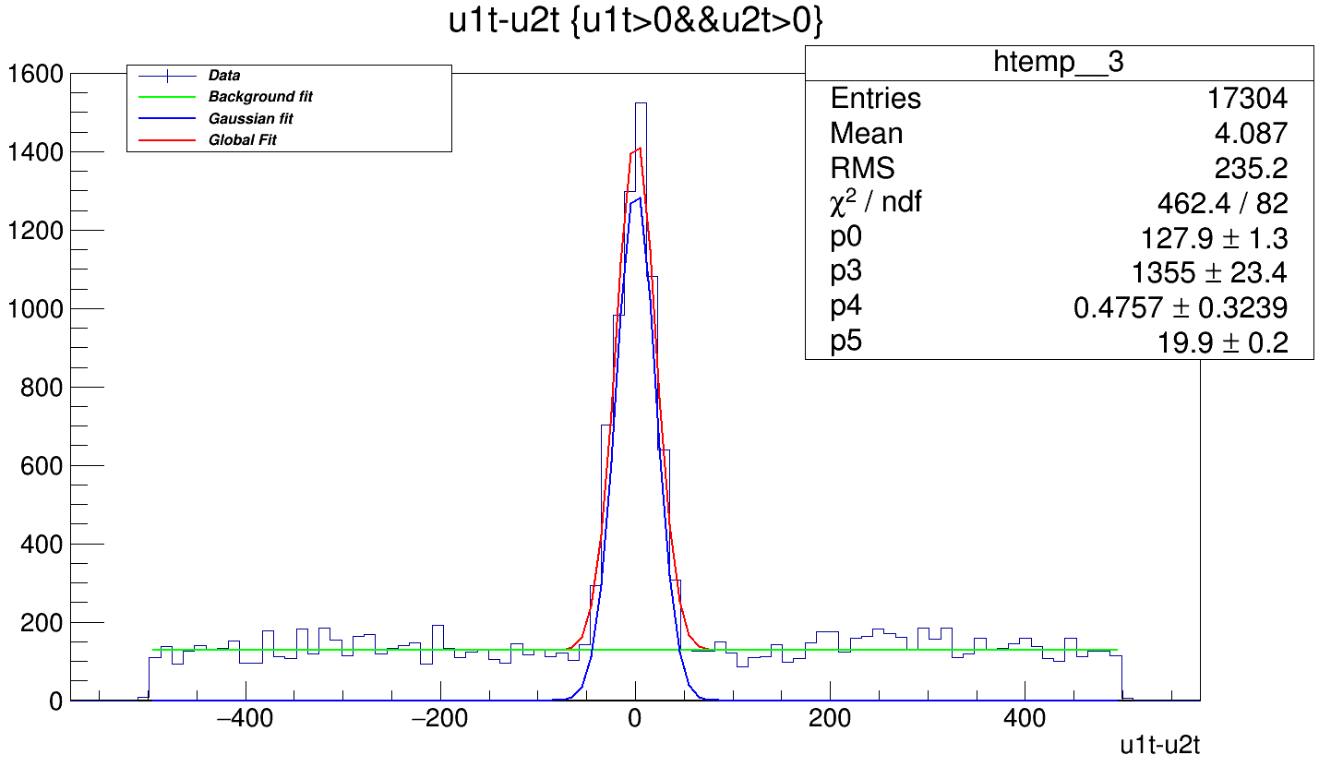
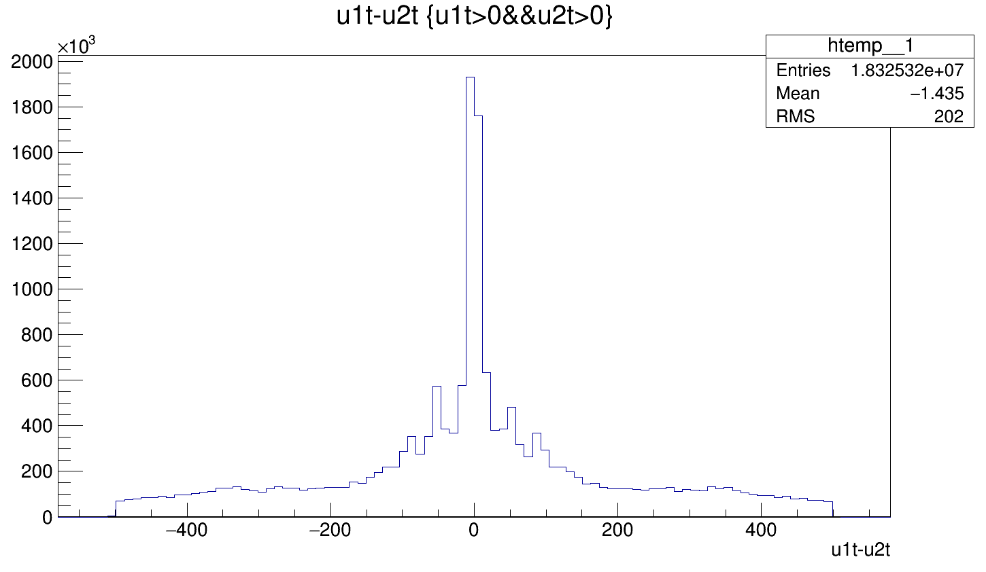



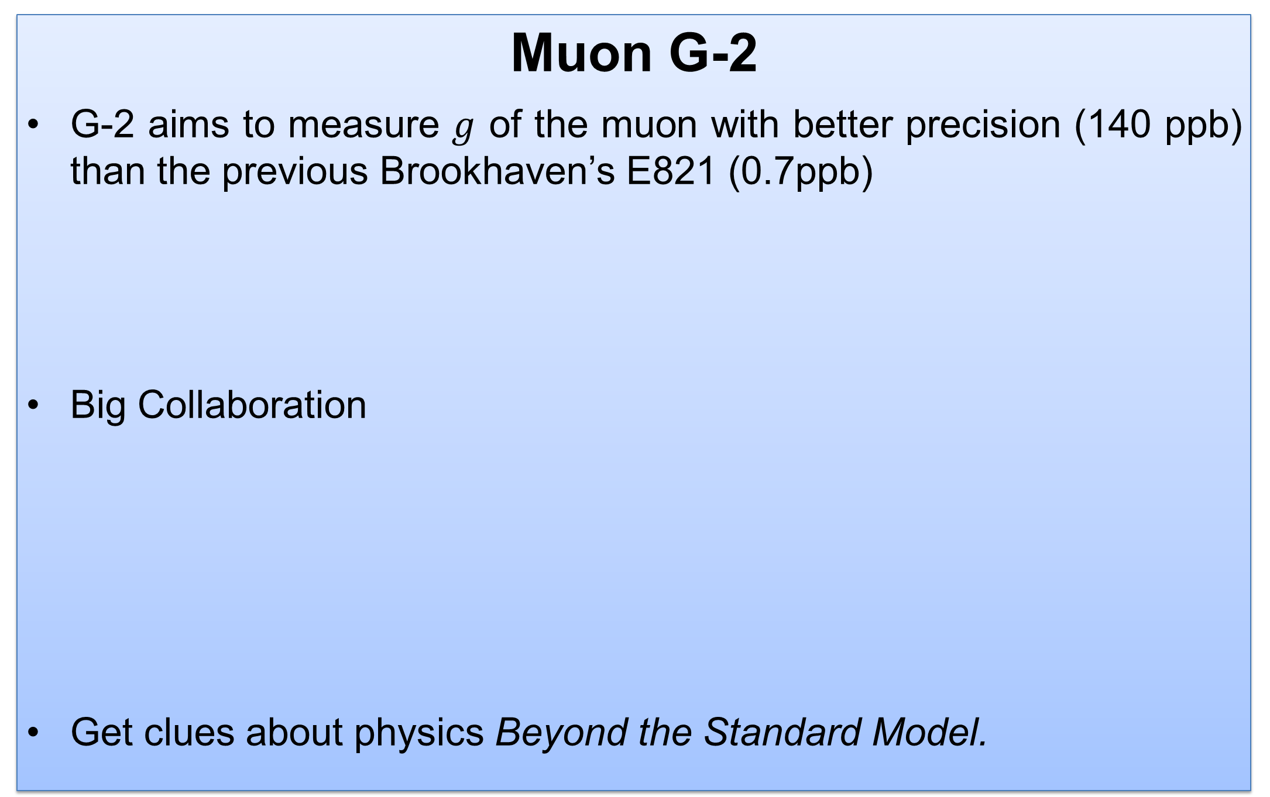
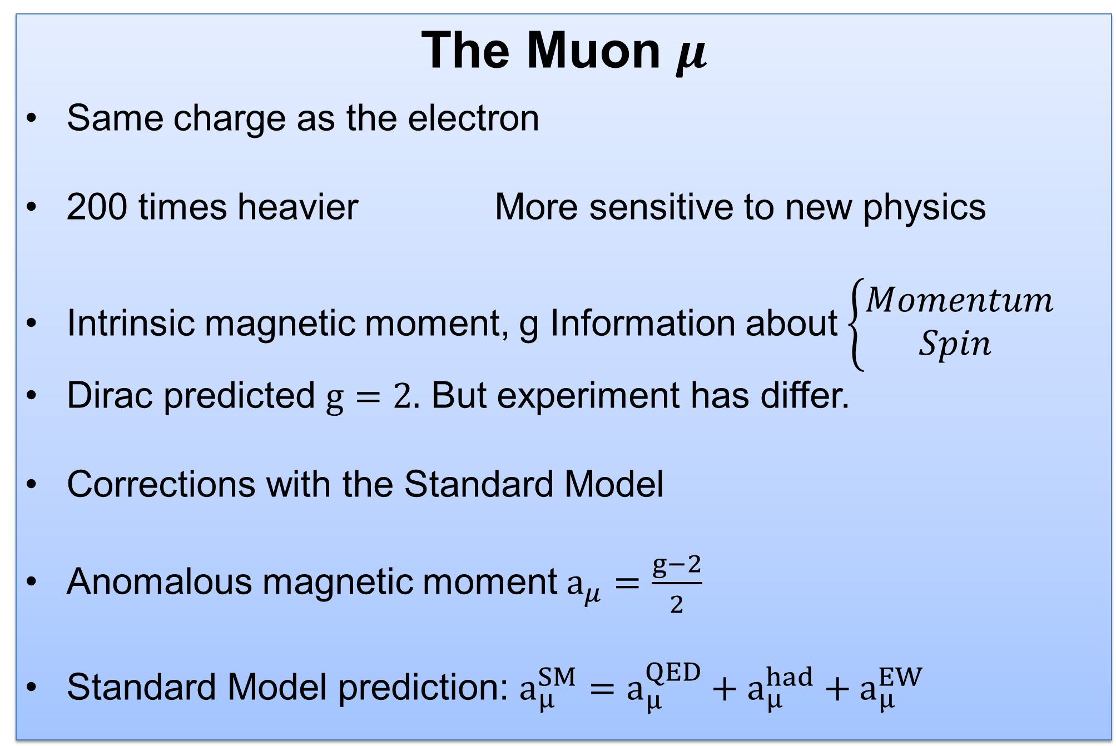


G-2 tracker test beam T1042
Sergio Daniel Hernández Charpak – Universidad de Los Andes
Mentored by Brendan C Casey – Fermi National Laboratory
Abstract
The Muon g-2 experiment is on the frontier of Particle Physics. Its tracker system is based on Straw Detectors. A prototype of these has been successfully tested in Fermilab’s Mtest Facility during June 2015. During this test, a High Voltage (HV) supply powered the straws and was operated at different voltages. During the offline analysis of this data, variation of parameters as Threshold, HV, beam rate and type of gas were subject of study. An inverse proportion relation was found between threshold and noise (higher threshold, lower noise) but more detailed analysis is needed for more conclusive results.
The Muon $μ$
Same charge as the electron
200 times heavier More sensitive to new physics
Intrinsic magnetic moment, g Information about$\left\{\begin{aligned}Momentum \\ Spin \end{aligned}\right.$
Dirac predicted $g=2.$ But experiment has differ.
Corrections with the Standard Model
Anomalous magnetic moment $a_{μ}=\frac{g−2}{2}$
Standard Model prediction: $a_{μ}^{SM}=a_{μ}^{QED}+a_{μ}^{had}+a_{μ}^{EW}$
Muon G-2
G-2 aims to measure $g$ of the muon with better precision (140 ppb) than the previous Brookhaven’s E821 (0.7ppb)
Big Collaboration
Get clues about physics Beyond the Standard Model.
Image 2 - Straw tracker – Summer 2015
Tracker
Straw trackers measure the beam profile as a function of time
3 stations located at 15°, 180° and 270° from injection point.
8 modules per station.
1 module 4 layers of straws
1 layer 32 straws wide
U V layers
Straw parameters
Wall Material | Aluminized Mylar
Wall thickness | 15$μm$
Wire Material | Gold plated Tungsten
Wire diameter | 25 $μm$
Straw length | 10 cm
Stereo angle | $±7,5°$ from vertical
Operating Voltage | 1800 V
Image 1 – G-2 Collaboration in the storage ring – July 2015
Test Beam June 2015
MTest (FNAL)
2 weeks
120 GeV protons
Tracker module
Ar-CO2 & Ar-Ethane
High Voltage
Iseg EHS 8220p-F
Switched Mode Power Supply (Supply)
Low ripple and noise
Resolution few pA
Remotely controllable via SNMP
Friendly GUI
Operated at 1400-1500-1600-1700-1800 V
Ramp speed of 5%
Current trip of 20 $μA$
MWPC
Silicon
Vacuum chamber
Table 1 – Straw Parameters
FLOBBER
u1
v1
Image 5 – HV plugged in
u2
v2
Tracker
32 straws long
Motion table
FLOBBER cooling
Image 3 – Test Beam June-July 2015
Image 4 – Test Beam Team June 2015
Image 6 – Iseg SNMP GUI
Image 7 – Straw UV 4 layers
Test Beam Data Analysis
Existing gm2 simulation and analysis software (Geant4/Art, C++, Root)
Straw digits hits per layer
Time Differences between hits by layer
Hits which are less than 500 ns apart
Looping for hits in 4 layers
Argon:Ethane (50:50)
Argon:Co2 (80:20)
Results
$Δt≈0$ Hits are correct.
Gaussian and flat noise fit
Most are beneath the Gaussian.
Higher Threshold – Less noise
Differences between gas unclear
Still more analysis to do looking more into detail in all the parameters.
*Readout Electronics Threshold
Run 405 – Threshold* 400mV – HV 1800 V – Beam Rate 100k
Run 314 – Threshold* 300mV – HV 1500 V – Beam Rate 10k
Run 413 – Threshold* 1000mV – HV 1800 V – Beam Rate 100k
Run 340 – Threshold* 1200mV – HV 1600 V – Beam Rate 10k
Conclusions
Experiment in the frontier of the Standard Model
Test beam was an opportunity to see collaboration happen
Operated the HV module and gained knowledge about it.
The time differences between straw layers $≈0$. The hits registered by the straws represent the reality.
The higher threshold, the less noise.
There is still analysis to be done.
References
"Muon G – 2 Technical Design Report." Fermi National Accelerator Laboratory, 15 June 2015. Web. 26 June 2015.
Li, Liang. "Muon G-2 Experiment at Fermilab." Shanghai Jiao Tong University, 5 June 2013. Web. 15 June 2015.
Acknowledgments
Brendan C Casey – Fermi National Laboratory
Thomas Stuttard – University College of London
Tammy Walton – Fermi National Laboratory
Brendan Kiburg - Fermi National Laboratory
August 2015

